Slide 1

Global Design Learning Journey
May 2021 | David Bishop, Ritesh Shetty, Paul Olyslager, Bruno Perez

Slide 2

Learning Journey Guiding Principles The Platinion design learning journey adheres to a set of principles
The Learning Journey Is Aligned With The Career Development Framework
The Learning Journey
Is Aligned With
The Design Playbook
There Is Flexibility In
The Learning Journey
BCG-taught Courses
Are Favored
There Are
Regional Differences
This includes both core skills and soft skills, and means that one should be able to find learning resources regarding any skill, as you advance.
The categorization and wording is similar if not identical.
The design playbook includes design methods, approaches, and an organizational scheme for the methods. The learning journey's framework, approaches, and organization is aligned to the playbook.
Background and education is different for everyone; the learning journey provides necessary resources to up-skill, but not every element is required if you already have a particular skill.
Electives allow exploration into adjacent domains and deep dives into topics of interest.
BCG, Platinion, and Design Chapter resources are favored as sources, and are augmented by vetted external sources like LinkedIn, Coursera, Interaction Design Foundation (IDF).
We favor impartial authorities like associations and professional societies over for-profit entities (except for a company's own training for a design tool like Figma).
The learning journey endeavors to be consistent and concise, but there are regional differences. These differences are necessary for some topics because not all resources are available in all regions, but the top level journey is globally consistent.
Skills (in the Career development Framework) are required; Courses (in the Learning Journey) typically are not required (especially smaller methods courses)

Slide 3
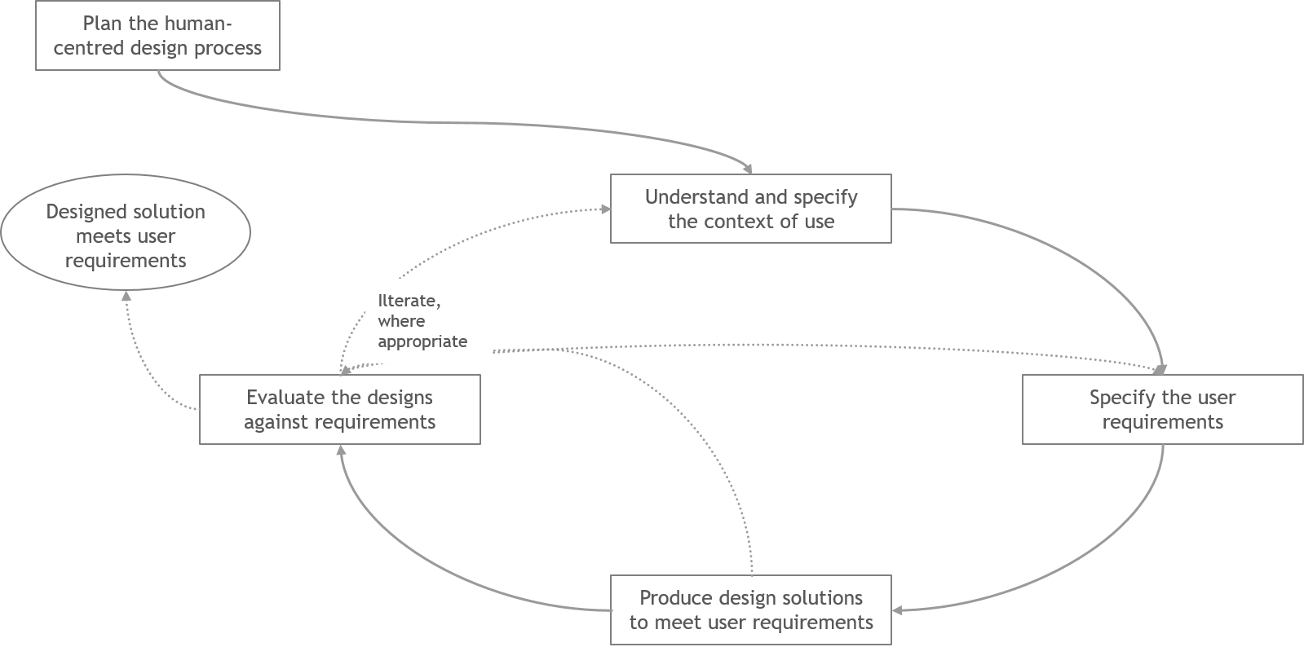
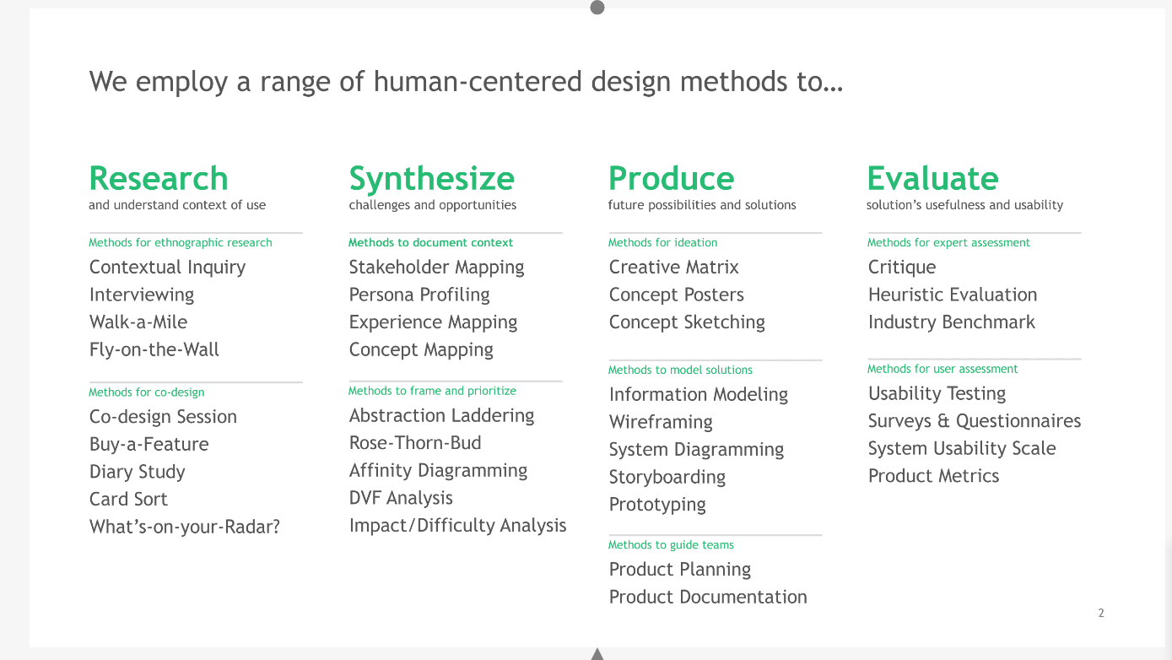
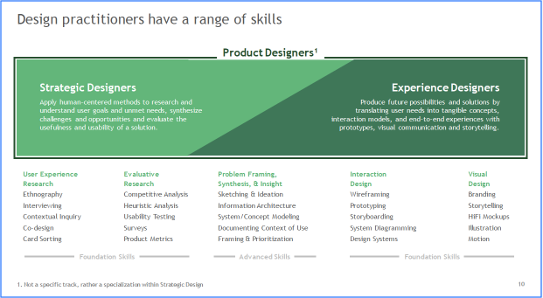
Platinion Design Chapter Resource Map
Showing interconnectedness between:
The Design Playbook
The Design Learning Journey
The Design Skills Maturity Model
The HCD Fundamentals Course
To be simplified
Methods align with standards
Design Methods are organized into categories
1.
Overview
2a.
Framework
2b.
Offerings
3a.
Approach
3b.
Methods
4a.
Practitioners
4b. Working Models and
Studios
5.
Skills
Maturity
Model
8 sections to
the Playbook
Methods in Course are from the Playbook
(external)
(external)
Platinion
Design
Playbook
Platinion HCD
Fundamentals
Course
LAB
IDF
LinkedIn
Learning
(more)
Course is aligned
with the playbook
Learning Journey
includes Playbook
Approach & Methods
Core Skills are the Methods in
the Playbook
Platinion Design
Learning
Journey
Core Skills
Soft Skills
BCG and Platinion provide a
number of learning options
for Core and Soft skills
Learning
Sources
contains
The Maturity Model
is in the Playbook
Skills needed are in
the Learning Journey
same
same
Platinion Design Skills Maturity
Model
Core Skills
Soft Skills
contains

Slide 4
Platinion Design Chapter Resource Map
Showing interconnectedness between:
The Design Playbook
The Design Learning Journey
The Design Skills Maturity Model
The HCD Fundamentals Course
db 26.May.21: Simplified version; is it good enough to include? HMW focus on Skills Maturity Model? (which is a bit hidden down and to the left)
db 26.May.21: what are other sources for external courses? E.g. I think I saw Dale Carnegie for one region; we use Brandspeak in the US as well as Work Smarter Live Better
db 26.May.21: HMW we show external examples of sources for electives e.g. Measuring Usability, Lean UX
Favored
(External)
(Self-guided)
(External) (Taught)
(External)
Platinion
Design
Playbook
LAB
IDF
LinkedIn,
Coursera,
…
Brandspeak, WSLB.com
Design Tools Vendors (e.g. Figma, Dscout, Miro, InVision)
Learning Journey
includes Playbook
Approach & Methods
Core Skills are the Methods in
the Playbook
Platinion Design
Learning
Journey
Core Skills
Soft Skills
BCG and Platinion provide a
number of learning options
for Core and Soft skills
Learning
Sources
contains
The Maturity Model
is in the Playbook
Skills needed are in
the Learning Journey
same
same
Platinion Design Career Development Framework
Core Skills
Soft Skills
contains

Slide 5
Learning Journey Overview
Level 1 - Designer
Level 2 – Sr. Designer
Level 3 – Lead Designer
Level 4 – Principal Designer
Strategic Designer
Mandatory
User Experience Research
User Experience Research
User Experience Research
User Experience Research
L1
L2
L3
L4
Evaluative Research
Evaluative Research
Evaluative Research
Evaluative Research
L1
L2
L3
L4
Digital Design Tools Orientation
Tools & Methods for Research & Evaluation
Tools & Methods for Research & Evaluation
Tools & Methods for Research & Evaluation
L1
L2
L3
L4
Problem Solving, Insight & Synthesis
Ideas & Insights
Insights & Intellectual Leadership
L2
L3
L4
Core Skills
Experience Designer
Mandatory
Interaction Design
Interaction Design
Interaction Design
Interaction Design
L1
L2
L3
L4
Visual Design
Visual Design
Visual Design
Visual Design
L1
L2
L3
L4
Digital Design Tools Orientation
Tools & Methods for Interaction & Visual Design
Tools & Methods for Interaction and Visual Design
Tools & Methods for Interaction and Visual Design
L1
L2
L3
L4
Problem Solving, Insight & Synthesis
Ideas & Insights
Insights & Intellectual Leadership
L2
L3
L4
Design Electives/ Specialty topics
Open for all levels
Measuring Usability / Statistics
Sketching & Illustration
Customer Journey
Ethics in Design
Transition Design
Topics added based on industry trends and future case needs
Lean UX, Agile
Product Design
Content Strategy
DesignOps
Speculative Design
Data Visualization
Product Management
Digital Tools Deep Dives
Lean Quantitative Research
Inclusive Design
Soft Skills
Practicality & Effectiveness
Practicality & Effectiveness
Value Creation
Value Creation & Impact
L1
L2
L3
L4
Communication & Presence
Communication & Presence
Communication & Influence (incl. PLF)
Communication & Influence (Incl. CLF)
L1
L2
L3
L4
Client Interaction
Client Interaction
Relationship Management
Relationship Dev. & Commercial Drive (incl. ACLP)
L1
L2
L3
L4
Team Contribution
Team Contribution
Project Management (incl. PLF)
Project Management
L1
L2
L3
L4
BCG Consulting Foundation
Team Management (incl. APLF)
People Development (incl. CD Advisor training)
BCG/Platinion Onboarding
New Hire Orientation
Senior Hire Orientation
Other region specific trainings

Slide 6
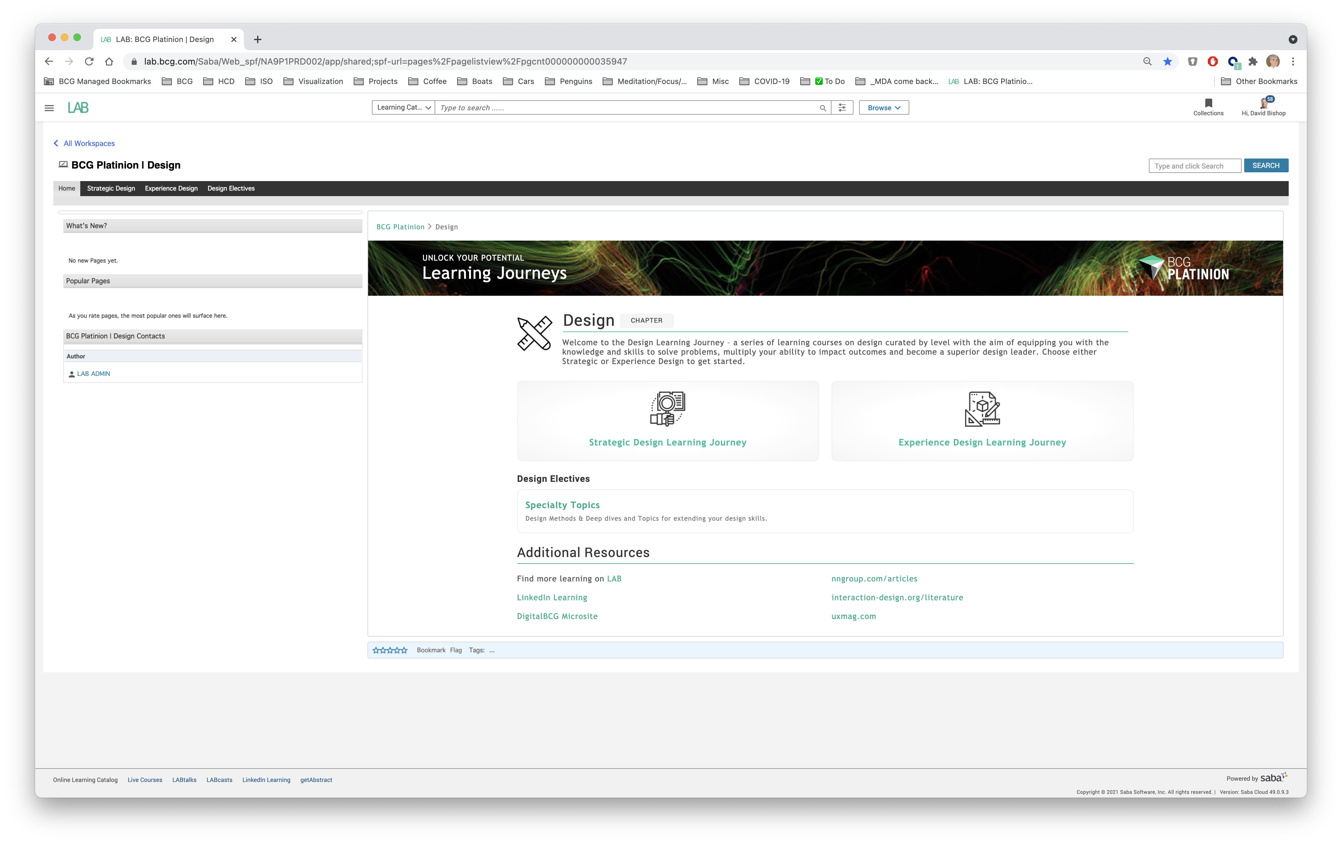
db 26.May.21: this is shown to make a connection from the LJ to ”the LJ in LAB” – HMW annotate or be clearer about the connection/synergy?

Slide 7
Learning Journey – Topic List Example
WORK IN PROGRESS
Level 1 - Designer
Level 2 – Sr. Designer
Level 3 – Lead Designer
Level 4 – Principal Designer
Strategic Designer
Mandatory
User Experience Research
User Experience Research
User Experience Research
User Experience Research
L1
L2
L3
L4
Interviewing
Co-design
Card Sorting
Contextual Inquiry
Diary Study
Topic
Topic
Topic
Topic
Evaluative Research
Evaluative Research
Evaluative Research
Evaluative Research
L1
L2
L3
L4
Heuristic Evaluation
Usability Testing
Concept Testing
User Experience Audit
MVT Testing
Surveys
Competitive Analysis
Topic
Topic
Topic
Topic
Topic
Topic
Core Skills
Digital Design Tools Orientation
Tools & Methods for Research & Evaluation
Tools & Methods for Research & Evaluation
Tools & Methods for Research & Evaluation
L1
L2
L3
L4
Figma
Remesh
Dscout
Dovetail
Topic
Topic
Topic
Topic
Topic
Topic
Topic
Topic
Topic
Problem Solving, Insight & Synthesis
Ideas & Insights
Insights & Intellectual Leadership
L2
L3
L4
Customer Journey Mapping
Persona Profiling
Experience Mapping
Topic
Topic
Topic
Customer Value Proposition
Business Model Canvas
Design Sprint
Innovation Sprint

